Slide 1


BACTERIA SEARCH ENGINE
Cloud computing final project
Matteo Migliarini 1886186
Giuseppe Di Poce 2072371
Enrico Grimaldi 1884443

Slide 2
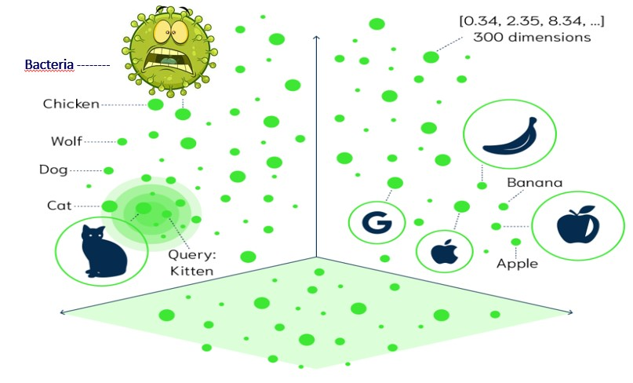
Problem Description
Weaviate vectorial database to implement an image search engine;
The goal of the project is to develop an application that uses Weaviate to create a search engine for images of bacteria. Weaviate is known for its speed and flexibility, allowing for efficient search operations on large datasets.
The process involves using a pre-trained neural network to extract features from the images and generate vector embeddings. These embeddings are then stored in the Weaviate database, enabling quick searches for similar images based on a given query image.
When a user uploads an image, Weaviate computes the vector embedding for that image and compares it with the embeddings of reference images in the index to find the most similar matches.
Bacteria Search Engine
Cloud Computing final project
Pagina <number>

Slide 3
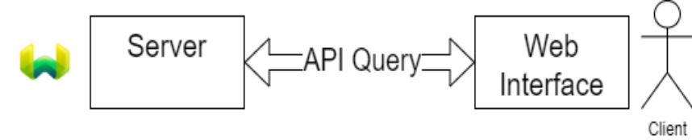
Solution implementation
we want to implement a scalable web application, capable of rapid elasticity.
The application is divided into microservices:
Web Interface: The client-side is a fat client, where a static HTML/CSS/JS webpage is served from an edge node.
The webpage performs API calls to the server to query and retrieve results.
The client performs computations to update the webpage, but it shouldn't be computationally intensive.
API Call: The server-side implements a REST API, particularly using POST requests to handle the query image in the request payload and return a list of images in the response.
Vector Database: Weaviate is chosen as the vector database. It uses vector representations of items and cosine similarity to find similar items to a query. The vector database consists of a pretrained neural network that transforms items into vectors and the database software itself, which handles queries, schema, and vector-item mappings.
Bacteria Search Engine
Cloud Computing final project
Pagina <number>

Slide 4
Docker Containers
To ensure consistent and reliable deployment across different environments, the application utilizes Docker containers for Weaviate (vector database) and
the pre-trained neural network. Docker provides a lightweight and portable solution, encapsulating the entire application stack along with dependencies and
configurations.The deployment is defined using a YAML file. Weaviate is defined as a service with specific configuration settings, including the
image, port, environment variables, and volumes. The neural network service is also defined with its corresponding image and environment
settings, including GPU capabilities. By using Docker containers, the application achieves reproducibility and self-contained environments, eliminating
potential issues related to variations in infrastructure. Each container can be allocated specific computing resources, ensuring optimal performance and
preventing negative impacts on other components. The system can scale by deploying multiple containers in parallel, achieving high availability and
load balancing.The lambda function is decoupled from user interactions and triggered only when an image is uploaded to the web app. This decoupling
allows for greater scalability and responsiveness. The Lambda function can be invoked as needed, providing real-time responses without continuous
resource allocation.
Overall, Docker containerization technology enables the creation of a robust and scalable system that delivers optimal performance, flexibility, and
ease of management.
Titolo Presentazione
Pagina <number>

Slide 5
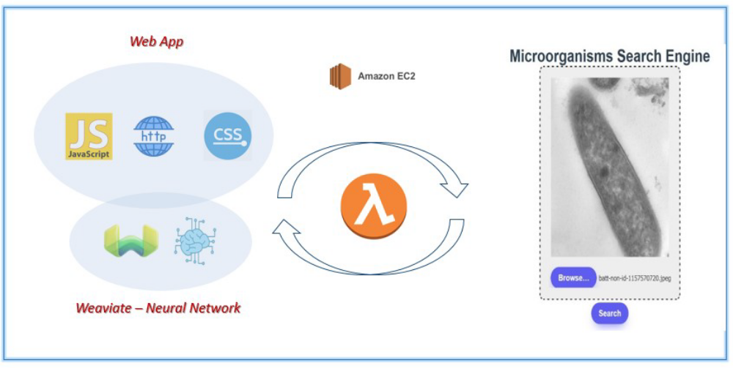
Why to scale?
EC2 modus operandi
Scaling the application enhances performance by distributing the workload across multiple EC2 instances, reducing response times, and improving query processing. It also enhances availability by using multiple instances and an elastic load balancer to redirect traffic in case of instance failure;
Scaling provides flexibility in resource allocation, allowing resources to be adjusted based on demand. It also helps plan for future growth, accommodating an increasing user base and traffic.
Bacteria Search Engine
Cloud Computing final project
Pagina <number>

Slide 6
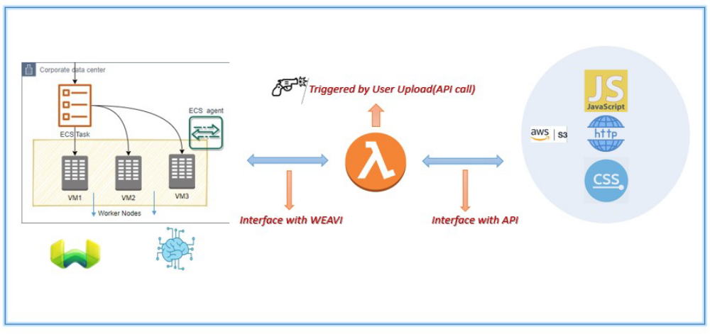
Why to scale?
ECS modus operandi
This solution leverages Amazon ECS. Docker images are pushed to Amazon ECR, and ECS task definitions and services are created. Both service runs on the same EC2 instance, and load balancing is achieved through an Application Load Balancer (ALB).
Scaling, monitoring, and adjustment of resources are performed for each ECS service based on specific requirements. This approach provides better performance optimization by allowing separate scaling policies for different components.
Bacteria Search Engine
Cloud Computing Project
Pagina <number>

Slide 7
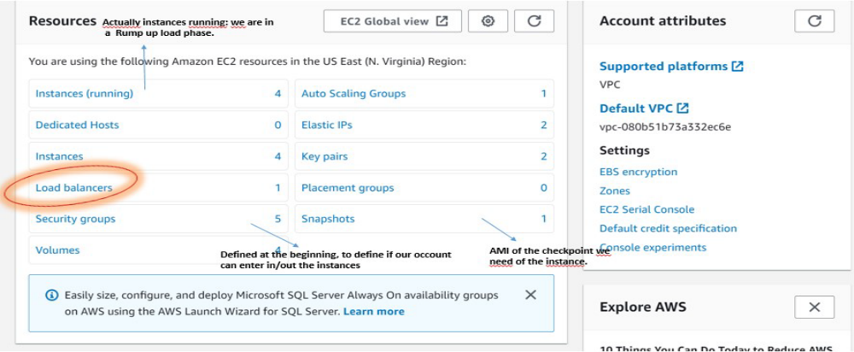
Scalable Architecture
To deploy the application and create a scalable architecture, the following steps are involved:
4.1 Create Virtual Private Cloud (VPC):.
4.2 Launch EC2 Instance:
4.3 Create Web Group & Define EC2 Rules:
4.4 Scale and Load Balance the Architecture:
Configure the ALB with a minimum and maximum number of instances, such as a minimum of 2 and a maximum of 6 EC2 instances.
The ALB makes intelligent routing decisions based on the content of the HTTP/HTTPS client requests, ensuring high availability and scalability.
Titolo Presentazione
Pagina <number>

Slide 8
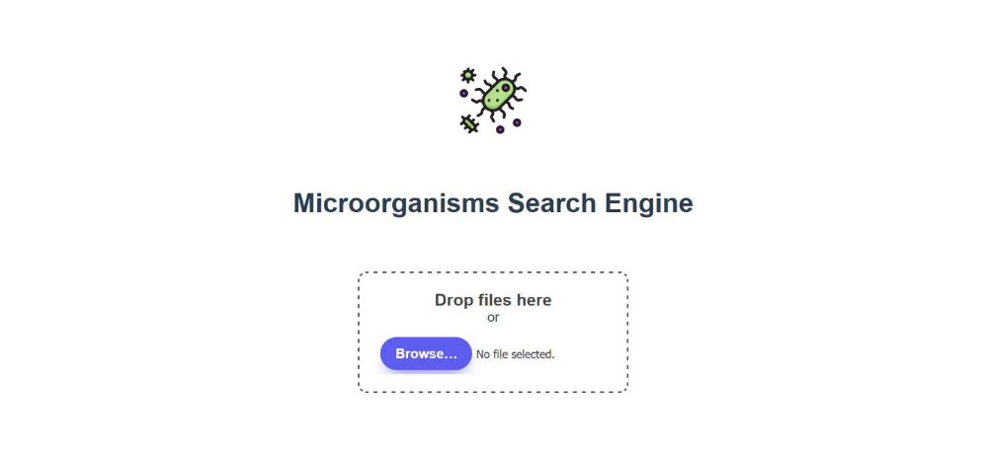
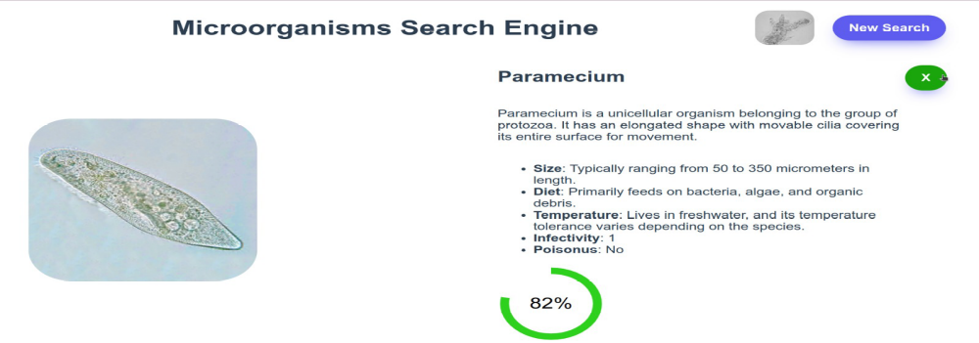
Web App results
The clinet will upload here the query image of bacteria
This event will act as a trigger for our lambda function.
Claim that the lambda interface with the API with the
Web app and with the EC2 instance to communicate
With Weaviate.
Each image will have a description of each type of bacteris.
Titolo Presentazione
Pagina <number>

Slide 9
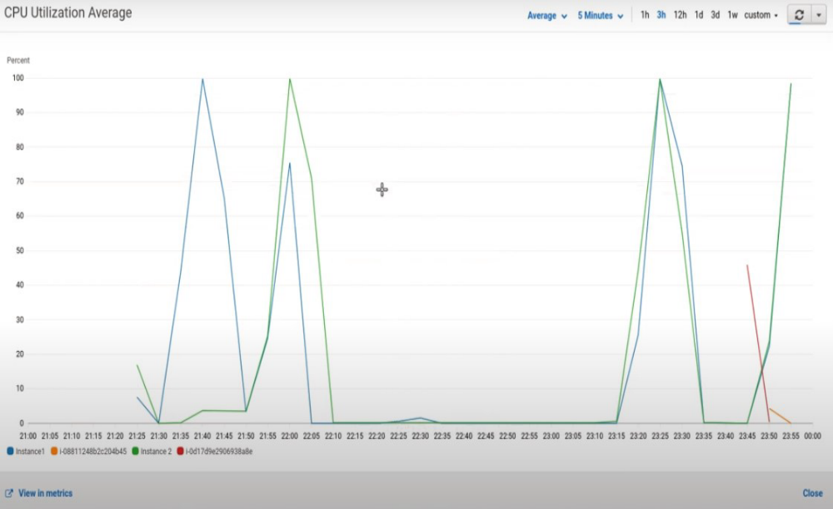
Scalability results
Titolo Presentazione
Pagina <number>

